Slide 1
Linked List

Slide 2
Categories of data structures
Data structures are categories in two classes –
Linear data structure:
- organized into sequential fashion
- elements are attached one after another
- easy to implement because follow the computer memory organization
- Traversing is very easy
- Examples – array, linked list, stack, queue etc.
Non - Linear data structure:
-every item is attached with many other items.
- data elements are not organized in a sequential fashion
- data cannot be traversed in a single run.
- Implementation is difficult
- Examples – tree, graph etc.

Slide 3
Array vs Linked Lists
Access :Random / Sequential
Array elements can be randomly accessed using subscript variable.
e.g. a[0],a[1],a[3] etc.
While random access of any node is not possible in linked list we have to traverse through the linked list for accessing element. So O(n) time is required for accessing particular element .
2 . Memory Structure :
Array is stored in contiguous Memory locations , i.e. suppose first element is stored at 2000 then second integer element will be stored at 2004 .
But in linked list it is not necessary to store next element at the consecutive memory location .
Element in linked lists are stored at any available location , but the pointer to that memory location is stored in previous Node.

Slide 4
Array vs Linked Lists
3 . Insertion / Deletion
As the array elements are stored in consecutive memory locations , so while inserting elements we have to create space for insertion.
So more time is required for creating space and inserting element
Similarly if we have to delete the element from given location and then shifting of all successive elements towards left is required
In linked list we have to just change the pointer address field (pointer),so insertion and deletion operations are quite easy to implement
4 . Memory Allocation :
In case of array, generally memory allocated is done at compile-time in stack area.
In linked list, memory is allocated at run-time , using dynamic memory allocation in heap area using functions like malloc, calloc and new etc.

Slide 5
Lists Implementation
Linked List –
Collection of similar data elements stored at discrete memory locations and connected
by pointer (link). Hence size can grow or shrink at any point of time.
Data elements are called nodes
Types –
Linear linked list or singly linked list or one way list
Doubly linked list or two way list
Circular linked list
Header linked list

Slide 6
Linear Linked list
Each node have two fields – 1. Information 2. Pointer to next node
Representation of node –
struct Node{
int INFO;
struct Node *NEXT;
};
For head –
struct Node *head
INFO
INFO
INFO
INFO | NULL
200
400
150
50
head

Slide 7
Operations on linear linked list
Creating empty linked list
Traversing
Insertion
Deletion
Searching
Sorting

Slide 8
Creating a linked list
struct Node{
int INFO;
struct Node *NEXT;
};
Algorithm Create_List()
Node * START
START= NULL
Return START
This function creates an empty linked list where START is a pointer pointing to created list.
//C program
struct Node* Create_List()
{ struct Node * START;
START= NULL;
return START;
}

Slide 9
Traversing of linked list
Traversing the Linked List:
This function visits each node of linked list only once. Temp is a temporary pointer to node. START is the pointer pointing to starting of list.
Algorithm Traverse_List(START)
Node * Temp
Temp = START
While (Temp != NULL)
Print Temp -> INFO
Temp = Temp -> NEXT
void Traverse_List(Node START)
{
struct Node * Temp; //Temp pointer
Temp= START;
while (Temp!= NULL)
{
printf(" %d ", Temp -> INFO );
Temp = Temp ->next;
}
}

Slide 10
Insertion
Three ways to insert a node into linked list –
Insert at beginning
Insert after specified location
Insert at the end (appending node)

Slide 11
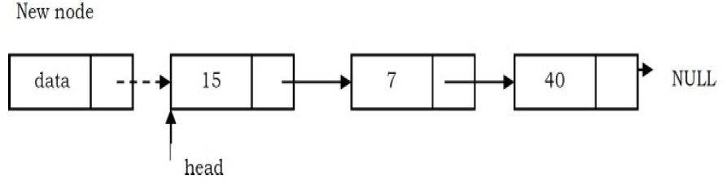
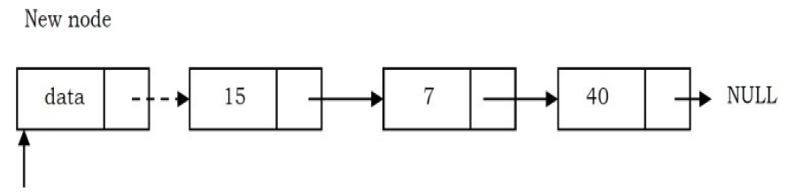
Insertion at beginning of linked list
In this case, a new node is inserted before the current head node. Only one next pointer needs to be modified (new node’s next pointer) and It can be done in two steps:
Step 1. Update the next pointer of new node, to point to the current head
Step 2. Update head pointer to point to the new node.

Slide 12
Insertion at beginning of linked list
Insert at the Beginning of the Linked List:
This function adds the node at the starting of linked list. New_Node is temporary pointer to node to be inserted into list. START is the pointer pointing to starting of list and info is the information of node.
Algorithm InsertBeg_List(START, info)
Node * New_node
New_Node = Allocate memory \\allocate memory for new node
New_Node -> INFO =info \\put info in INFO field of new node
New_node -> NEXT = START
START = New_node

Slide 13
Insertion at after specified location of linked list
This algorithm adds the node after the specified location of linked list. Temp is temporary pointers and New_Node is the pointer to the node to be inserted. START is the pointer pointing to starting of list and info is the information of node. Loc is the numbered location after which node is to be inserted. i is a loop variable.
Algorithm InsertAfter_List(START, info, Loc)
Node * Temp, *New_node
New_node = Allocate memory
New_node -> INFO = info
Temp = START
If (START == NULL) \\ if there is no node in list then make new node START
START = New_Node
New_node -> NEXT =NULL
Else
For i=1 to Loc-1
Temp = Temp -> NEXT
If (Temp == NULL) //if Loc is greater than number of nodes
Print “Loc is greater than number of nodes”
Return
New_node -> NEXT = Temp -> NEXT
Temp -> NEXT = New_node

Slide 14
Insertion at End of linked list (Appending node)
Append node in a Linked List: Below function adds the node at the end of linked list. New_Node is the node to be appended and Temp is temporary pointer. START is the pointer pointing to starting of list and info is the information of node.
Algorithm Append_List(START, info)
Node* New_Node, *Temp
New_Node = Allocate memory \\allocate memory for new node
New_Node -> INFO =info \\put info in INFO field of new node
New_Node -> NEXT = NULL \\make it last node by keeping NULL in NEXT field
If (START == NULL) \\ if there is no node in list then make new node START
START = New_Node
Else
Temp = START
While (Temp -> NEXT != NULL)
Temp = Temp ->NEXT
Temp -> NEXT = New_Node

Slide 15
Deletion
Three ways to delete a node from linked list –
Delete from beginning
Delete after specified location
Delete from the end
NOTE: Deletion could be done on the basis of given data. Here, first find that node and then delete it.

Slide 16
Deletion from the beginning of linked list
This algorithm deletes the node from the starting of linked list. Temp is temporary pointer. START is the pointer pointing to starting of list.
Algorithm DeleteBeg_List(START)
Node* Temp = START
If START ==NULL
Print “Empty Linked List”
Return
START = START -> NEXT
Free Temp

Slide 17
Deletion after specified location of linked list
This algorithm deletes the node after the specified location of linked list. Temp and Temp1 are temporary pointers. START is the pointer pointing to starting of list. Loc is the numbered location from where next node is to be deleted. i is a loop variable.
Algorithm DeleteAfter_List(START, Loc)
Node* Temp, *Temp1
Temp = START
For i=1 to Loc-1
Temp = Temp -> NEXT
If (Temp->NEXT==NULL)
Print “Either Loc is Last node or greater than Total number of nodes”
Return
Temp1 = Temp ->NEXT
Temp -> NEXT = Temp1 -> NEXT
Free Temp1

Slide 18
Deletion from the End of linked list
This algorithm deletes the node from the end of the linked list. Temp and Temp1 are temporary pointers. START is the pointer pointing to starting of list.
Algorithm DeleteEnd_List(START) –
Node * Temp, *Temp1
Temp1 = START
If START==NULL //checking Empty Linked list
Print “Empty Linked List”
Return
If(START->NEXT==NULL) // check single node list
START=NULL
Free Temp1
Return
While (Temp1 -> NEXT != NULL)
Temp =Temp1
Temp1 = Temp1 -> NEXT
Temp -> NEXT = NULL
Free Temp1

Slide 19
Searching element in singly linked list
Only linear search – As there is no way to find out the middle of linked list.
This algorithm searches the node in linked list. Temp is temporary pointer. START is the pointer pointing to starting of list and info is the information of node to be searched. If element is found then Loc is used to returned the location of node in list.
Algorithm SearchUnsorted_List(START,info) –
Node *Temp
Initialize Loc = 0
Temp = START
If Temp==NULL //empty linked list
Exit
While (Temp != NULL)
Loc = Loc +1
If (Temp->INFO == info)
Return Loc OR Temp
Temp = Temp -> NEXT
Return NULL // return NULL when element node found

Slide 20
Searching element in sorted singly linked list
This function will search the node in linked list. Temp is temporary pointer. START is the pointer pointing to starting of list and info is the information of node to be searched. If element is found then Loc is used to returned the location of node in list.
Algorithm SearchSorted_List(START,info) –
Node *Temp
Initialize Loc = 0
Temp = START
If Temp==NULL
Exit
While (Temp != NULL)
Loc = Loc+1
If (Temp->INFO == info)
Return Loc OR Temp
Else If (Temp->INFO > info)
Return NULL
Temp = Temp ->NEXT
Return NULL

Slide 21
Reverse the singly linked list
This algorithm reverses the linked list. Pnode, Cnode and Nnode are temporary pointers. START is the pointer pointing to starting node of the linked list.
Algorithm Reverse_List(START) –
Node *Cnode, *Pnode, *Nnode
Cnode =START
Nnode = Cnode ->NEXT
Cnode -> NEXT =NULL
While (Nnode != NULL)
Pnode = Cnode
Cnode = Nnode
Nnode = Nnode ->NEXT
Cnode -> NEXT = Pnode
START = Cnode

Slide 22
Arrays Vs. Linked List
Array | Linked List
Elements stored at contiguous memory locations Size of array is static and can not be changed at later stage if need arise. | Elements stored at discrete memory locations No fixed size, can grow and shrink very efficiently
Traversing takes O(n) Time | Traversing takes O(n) Time
Searching – Unsorted list – Linear O(n) Sorted list – Binary O(log₂n) | Searching – Only Linear O(n)
Insertion – Shift all element one position right, Less efficient than in linked list | Insertion – Only some pointers need to be managed, more efficient than in array
Deletion – Shift all element one position left, Less efficient than in linked list | Deletion – Only some pointers need to be managed, more efficient than in array

Slide 23
Doubly Linked list
Each node have three fields – 1. Information 2. Pointer to next node
3. Pointer to previous node
Representation of node –
struct Node{
struct Node *PREV;
int INFO;
struct Node *NEXT;
};
typedef struct Node * Node;
For head –
Node START, END
N
 |  | N
START
END

Slide 24
Creating a doubly linked list
This function creates an empty linked list and START is a pointer pointing to created list.
Algorithm Create_DList() –
Node START, LAST
START= NULL
END = NULL

Slide 25
Traversing of Doubly linked list
This function visits each node of linked list only once. Temp is a temporary pointer to node. START and END are the pointers pointing to starting of list and end of list respectively.
Algorithm Traverse_DList(START, END) –
Node Temp
Temp = START
While (Temp != NULL)
Print Temp -> INFO
Temp = Temp -> NEXT
OR (from last to first)
Node Temp
Temp = END
While (Temp != NULL)
Print Temp -> INFO
Temp = Temp -> PREV

Slide 26
Insertion
Four ways to insert a node into doubly linked list –
Insert at beginning
Insert after specified location
Insert before specified location
Insert at the end (also known as appending)

Slide 27
Insertion at beginning of Doubly linked list
This function add the node at the starting of linked list. New_node is temporary pointer to node to be inserted into list. START is the pointer pointing to starting of list and info is the information of node.
Algorithm InsertBeg_DList(START, info) –
Node New_node
New_node = Allocate memory
New_node -> INFO =info
New_node -> NEXT = START
New_node ->PREV = NULL
If START!=NULL // linked list is not empty
START -> PREV= New_node
START = New_node

Slide 28
Insertion after specified location of doubly linked list
This function add the node after the specified location of linked list. Temp and Temp1 are temporary pointers. START is the pointer pointing to starting of list and info is the information of node. Loc is the numbered location after which node is to be inserted. i is a loop variable.
Algorithm InsertAfter_DList(START, info, Loc) –
Node Temp, New_node
Temp = START
For i=1 to Loc-1
Temp = Temp -> NEXT
If (Temp == NULL)
Exit
New_node = Allocate memory
New_node -> INFO = info
New_node -> NEXT = Temp -> NEXT
New_node ->PREV = Temp
(Temp -> NEXT) -> PREV = New_node
Temp -> NEXT = New_node

Slide 29
Insertion before specified location of D linked list
This function add the node before the specified location of linked list. Temp and New_node are temporary pointers. START is the pointer pointing to starting of list and info is the information of node. Loc is the numbered location before which node is to be inserted. i is a loop variable.
Algorithm InsertBefore_DList(START, info, Loc) –
Node Temp, New_node
Temp = START
For i=1 to Loc-1
Temp = Temp -> NEXT
If (Temp == NULL)
Exit
New_node = Allocate memory
New_node -> INFO = info
New_node -> NEXT = Temp
New_node ->PREV = Temp ->PREV
(Temp -> PREV) -> NEXT = New_node
Temp -> PREV= New_node

Slide 30
Insertion at End(Appending) of Doubly linked list
This function add the node at the end of linked list. New_node is temporary pointers. START and END are the pointers pointing to starting of list and end of list respectively. info is the information of node.
.
Algorithm InsertEnd_DList(START ,END, info) –
Node New_node
New_node = Allocate memory
New_node -> INFO =info
New_node -> NEXT = NULL
If (START == NULL OR END == NULL) \\ if there is no node in list
New_node -> PREV = NULL
START = New_node
END = New_node
Else
New_node -> PREV = END
END -> NEXT = New_node
END = New_node

Slide 31
Deletion
Four ways to Delete a node from linked list –
Delete from beginning
Delete after specified location
Delete before specified location
Delete from the end
NOTE: Deletion could be done on the base information (to be deleted) available at any
node or not. Here, first find that node and then delete it.

Slide 32
Deletion at beginning of linked list
This function delete the node at the starting of linked list. Temp is temporary pointer. START and are the pointers pointing to starting of list and end of list.
Algorithm DeleteBeg_DList(START,END) –
Temp = START
If Temp ==NULL
Exit
If (START == END) // Single Node
START = END =NULL
ELSE
(Temp ->NEXT) -> PREV =NULL
START = START -> NEXT
Free Temp

Slide 33
Deletion after specified location of linked list
This function delete the node after the specified location of linked list. Temp and Temp1 are temporary pointers. START is the pointer pointing to starting of list and info is the information of node. Loc is the numbered location from where next node is to be deleted. i is a loop variable.
Algorithm DeleteAfter_DList(START, Loc) –
Node Temp, Temp1
Temp = START
For i=1 to Loc-1
Temp = Temp -> NEXT
If (Temp == NULL)
Exit
Temp1 = Temp ->NEXT
Temp -> NEXT = Temp1 -> NEXT
(Temp1->NEXT) ->PREV = Temp
Free Temp1

Slide 34
Deletion before specified location of linked list
Algorithm DeleteBefore_DList(START, Loc) –
This function delete the node before the specified location of linked list. Temp and Temp1 are temporary pointers. START is the pointer pointing to starting of list and info is the information of node. Loc is the numbered location from where previous node is to be deleted. i is a loop variable.
Node Temp, Temp1
Temp = START
For i=1 to Loc-1
Temp = Temp -> NEXT
If (Temp == NULL)
Exit
Temp1 = Temp ->PREV
Temp -> PREV = Temp1 -> PREV
(Temp1->PREV) ->NEXT = Temp
Free Temp1

Slide 35
Deletion at End of linked list
This function delete the node at the end of linked list. Temp and Temp1 are temporary pointers. END is the pointer pointing to end of list.
Algorithm DeleteEnd_List(END) –
Node Temp, Temp1
Temp = END
If Temp==NULL
Exit
Temp1 = Temp -> PREV
Temp1 -> NEXT = NULL
END = Temp1
Free Temp

Slide 36
Singly Vs. Doubly Linked List
Singly Linked List | Doubly Linked List
Node has two fields. | Node has three fields.
Reverse traversing is not possible. | Reverse traversing is possible.
Insertion at the end of linked list takes O(n) time. | Insertion at the end of linked list take constant time
Deletion at the end of linked list take O(n) time and deletion before specified location is not possible. | Deletion at the end of linked list take constant time and deletion before specified location is also possible.

Slide 37
Exercises
Write an algorithm for searching in doubly linked list.
Write an algorithm to sorting a singly linked list.
Why reverse algorithm is not needed in doubly linked list. Justify your answer comparing with singly linked list.
Write an algorithm to delete the entire singly linked list or doubly linked list.

Slide 38
Circular Linked list
It could be singly or doubly linked list.
For singly circular linked list
Each node have two fields – 1. Information 2. Pointer to next node
Representation of node –
struct Node{
int INFO;
struct Node *NEXT;
};
data
data
data
data
200
400
150
50
LAST

Slide 39
Supported operations
All operation which can be performed on singly or doubly linked list can be extended to circular by maintaining last node next pointer to first node.
Creating empty linked list
Appending nodes to linked list
Traversing
Insertion
Deletion
Searching
Sorting
How do we know end of list ?
Compare next pointer field with address of first node or head

Slide 40
Circular Linked list
Advantages:
We can go to any node, in linear linked list it is not possible to go to previous node.
It saves time when we have to go to the first node from the last node. It can be done in
single step because there is no need to traverse the in between nodes. But in doubly
linked list, we will have to go through in between nodes.
Disadvantages: 1. It is not easy to reverse the linked list. If proper care is not taken, then the problem of
infinite loop can occur. 2. If we want to go back to the previous node, then we can not do it in single step. Entire
circle to be covered.

Slide 41
Circular Linked list(Insert at beginning)
Algorithm InsertBeg_List(LAST, info)
Node New_node
New_Node = Allocate memory \\allocate memory for new node
New_Node -> INFO =info \\put info in INFO field of new node
IF LAST==NULL
New_node -> NEXT = New_node
LAST=New_node
ELSE
New_node -> NEXT = LAST->NEXT
LAST->NEXT = New_node

Slide 42
Circular Linked list(Insert at the end)
Algorithm InsertAt_Last_List(LAST, info)
Node New_node
New_Node = Allocate memory \\allocate memory for new node
New_Node -> INFO =info \\put info in INFO field of new node
IF LAST==NULL
New_node -> NEXT = New_node
LAST=New_node
ELSE
New_node -> NEXT = LAST->NEXT
LAST->NEXT = New_node
LAST=New_node;

Slide 43
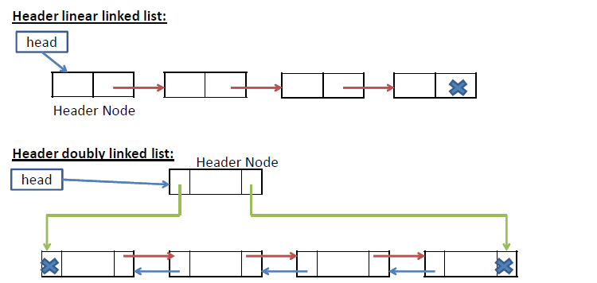
Header Linked list
A Header linked list is one more variant of linked list. In Header linked list, we have a special node present at the beginning of the linked list.
Header node keeps information about list like number of nodes, sorted or not sorted etc.

Slide 44
Application of Linked list
To implement scheduling algorithms in Operating Systems
To represent sparse matrices
To implement other data structures like stack, queue, tree etc.
To manipulate polynomials
Open a folder that has images. Use Microsoft Image Viewer to view the images. In the User Interface, '->' button is your node->next; The '<-' button is your node->prev.
The cache in browser. (allows you to hit back and fwd links URL’s through linked list)
Undo functionality in photo editors, text editors. (a linked list of different states)

Slide 45
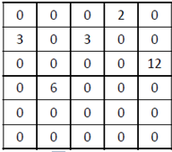
Sparse matrix representation

Slide 46
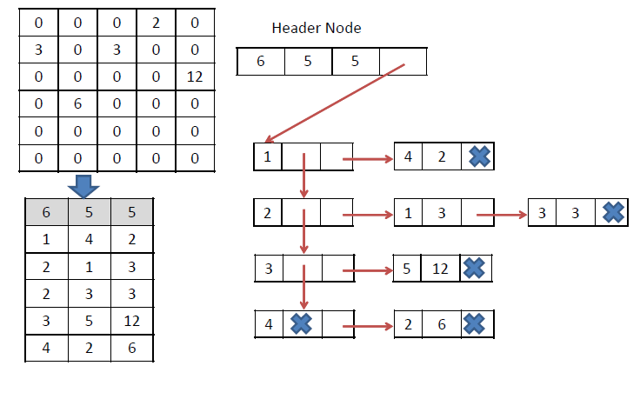
Sparse matrix representation

Slide 47
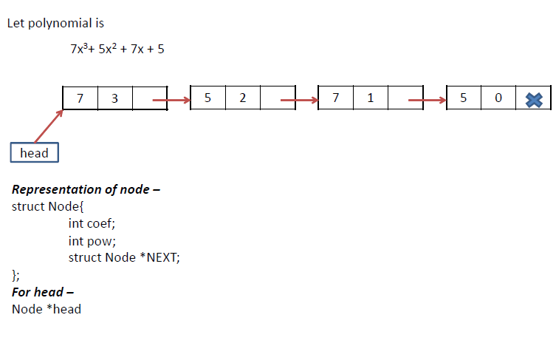
Polynomial representation

